Slide 1
Course Introduction
Prof. Dr. Dirk Riehle
Friedrich-Alexander University Erlangen-Nürnberg
AMOS A01
Licensed under CC BY 4.0 International
Notes:
It is Friedrich-Alexander University Erlangen-Nürnberg – FAU, in short.
Corporate identity wants us to say “Friedrich-Alexander University”.

Slide 2
Course Learning Goals 1 / 2 [1] [2] [3] [4]
To introduce students to agile methods by creating useful software.
[1] Professional = ambition + collaboration with external partner
[2] Agile methods = our focus here, specifically Scrum + XP
[3] We teach both overall processes as well as best practices
[4] Useful software is software that has value to someone!

Slide 3
Course Learning Goals 2 / 2
Learning objectives
  Gain conceptual understanding and practical skills of using
    agile software development methods
    software project management tools
    software development tools
  Learn how to work
    with an external stakeholder
    in a (student) project team
Project objectives
  Develop useful software
  Perform a great demo on demo-day!

Slide 4



















Industry Partners and Teaching Projects
...

Slide 5
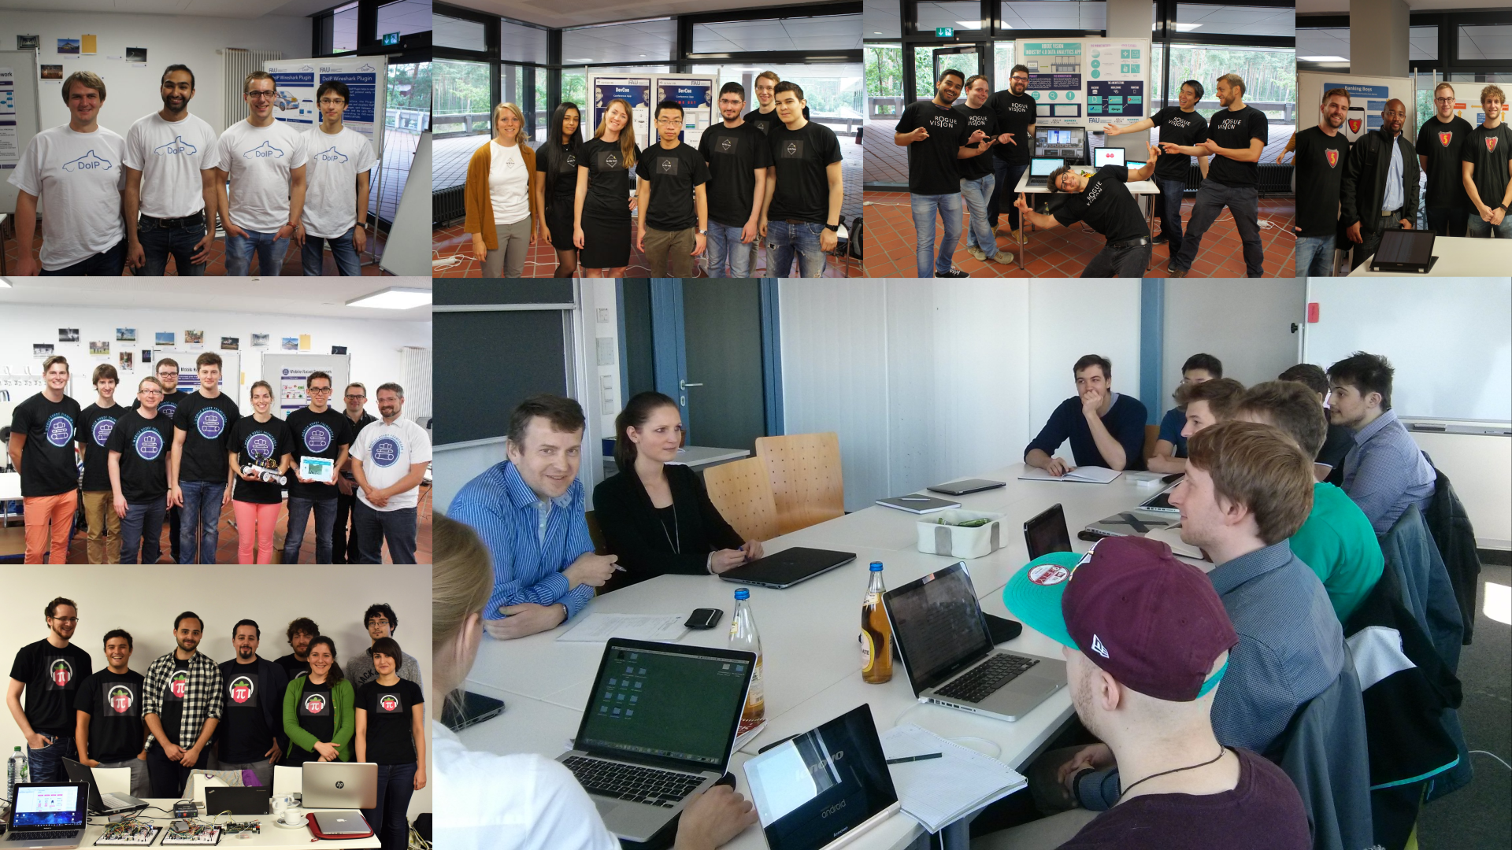

Slide 6
Skills Required for Course
General skills
  Willingness and ability to work in a team
  Ability to acquire skills during the project
Role-specific skills
  Product owner (PO) role
    Strong conceptual thinking
    Ability to communicate well
    Affinity to technology
  Software developer (SD) role
    Technology stack (specific to project)
    Development tools like git and GitHub
    Test-driven development

Slide 7
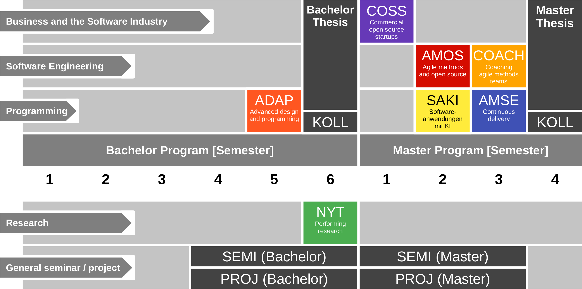
Course Position in Curriculum

Slide 8
Courses and Modules
 |  | Courses (Lehrveranstaltungen)
 |  | OSS-AMOS-VL | OSS-AMOS-UE (Team Meetings) | Total ECTS
Modules | OSS-AMOS-PO | x | x | 5
 | OSS-AMOS-SD | x | x | 10
NYT can be taken as
  5 ECTS VL + UE
  5 ECTS Seminar
  10 ECTS VL + UE
  10 ECTS Project
In various degree programs
Also as a Schlüsselqualifikation

Slide 9
Course Grading [1] by Role
Product Owner
  Theory (lectures) = 20% of grade
    2 SWS in 5 ECTS = 20%
    As measured by class quizzes
    Grading scale is [0..10] points
  Practice (project) = 80% of grade
    Individual contribution to teamwork = 50%
      As measured in team meetings
      Grading scale is [0|1|2|3]
    Independent work = 50%
      As measured by artifacts provided
      Grading scale is [0|1|2|3]
Combined by ECTS (credit point) proportions if both roles are played
Software Developer
  Theory (lectures) = 10% of grade
    2 SWS in 10 ECTS = 10%
    As measured by class quizzes
    Grading scale is [0..10] points
  Practice (project) = 90% of grade
    Individual contribution to teamwork = 50%
      As measured in team meetings
      Grading scale is [0|1|2|3]
    Independent work = 50%
      As measured by artifacts provided
      Grading scale is [0|1|2|3]
[1] Also see http://oss.cs.fau.de/teaching/course-resources/grading-schemes-and-scales/

Slide 10
Course Grading (All Roles)
Theory (lectures) = 10% of grade
  2 SWS in 10 ECTS = 10%
  As measured by class quizzes
  Grading scale is [0..10] points
Practice (project) = 90% of grade
  Individual contribution to teamwork = 50%
  Independent work (by role) = 50%
  Grading scale is [0|1|2|3]
  Percentage distribution by roles played

Slide 11
Receiving a Grade for the Course
If you want to receive a grade
  You must register through the course registration system during the registration period
    Course registration → https://campus.fau.de
  Course registration is different from course management
    Course management → https://studon.fau.de
If you cannot register through the course registration system
  Please follow the instructions at https://wp.me/PDU66-2bx
Otherwise: No grade

Slide 12

No Oral or Written Exam [1]
[1] You still have to register for the course

Slide 13
Course Language [1]
Class
  Lecturer: English
  Student: Choice of German or English
Project and exercises
  Team: Choice of German or English
  Submissions: Choice of industry partner
[1] http://osr.cs.fau.de/2012/03/10/english-or-german-deutsch-oder-englisch/

Slide 14
Course Organization
Course organization
  See https://amos.uni1.de
Course schedule
  See Schedule tab on Course Organization doc
Project descriptions
  See project descriptions on Course Organization doc
Project teams
  See Project Teams tab on Course Organization doc

Slide 15
The AMOS Project License
For source code, we use the MIT license
  See https://opensource.org/licenses/MIT
For other data, we use the CC BY 4.0 license
  See https://creativecommons.org/licenses/by/4.0/

Slide 16
Open Source Governance
Do not add copyleft-licensed libraries to your project
  May make later desired license change difficult, including proprietary use
  Check with teaching team whether library is OK
Rules of thumb on license choice
  OK: Permissive licenses (BSD, Apache)
  May be OK: Weakly protective (a.k.a. “weak copyleft”)
  Usually not OK: Strongly protective (a.k.a. “reciprocal” or “copyleft”)
  Never OK: Non-software licenses, no license
Professionals (i.e. companies) use code scanners to check

Slide 17
Work Rhythm
Lectures
  Class day (90min.)
Team meetings
  Next slot after lecture
Project work (self-organized)
  Deliverables due according to schedule

Slide 18
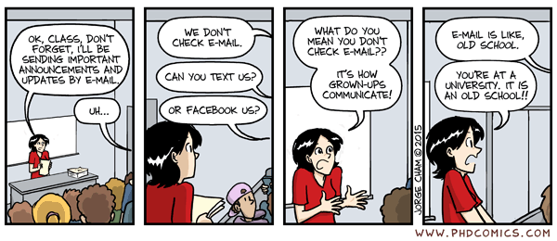
Course Communication
Announcements by email (through course management system)
Questions and answers using course communication forum
Use the Teaching Team email alias from Course Organization doc

Slide 19
Thank you! Questions?
dirk.riehle@fau.de – https://oss.cs.fau.dedirk@riehle.org – https://dirkriehle.com – @dirkriehle
DR

Slide 20
Legal Notices
License
  Licensed under the CC BY 4.0 International license
Copyright
  © 2010-2022 Dirk Riehle, some rights reserved

